Slide 1
Progress Report
Hengtao Guo
12/05/2018
Notes:
Hello, my name is Hengtao Guo, and I am a first year PhD student in Dr. Yan’s lab. My research focus lies on medical imaging and computational vision. Today it’s been my honor to give you a brief introduction about my recent work, the hybrid Deep Neural Networks for ALL-Cause mortality prediction from LDCT images

Slide 2
Contents
Location detection
Feature vector formulation
SVM classification
Result visualization
Next step
Notes:
I am going to illustrate this topic from four sections. Our motivations to do this, the ResNet Solution, our newly proposed Hybrid Risk Network Architecture and our future endeavors

Slide 3
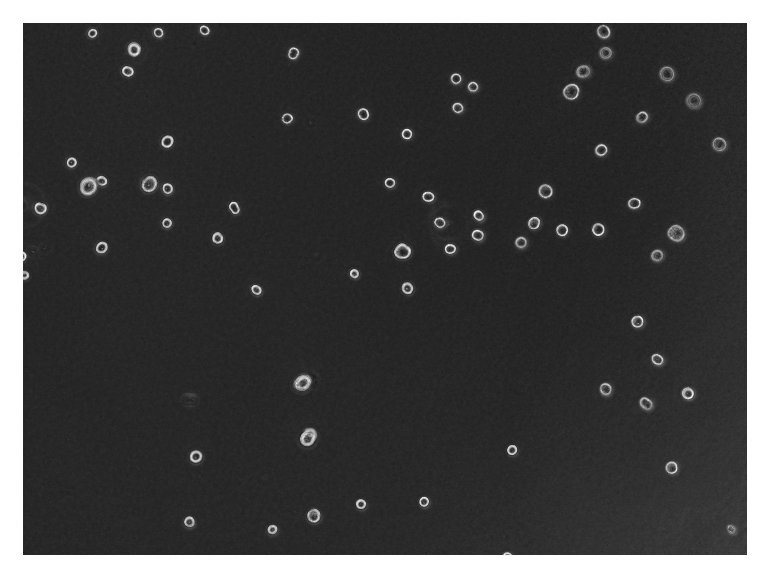

Slide 4
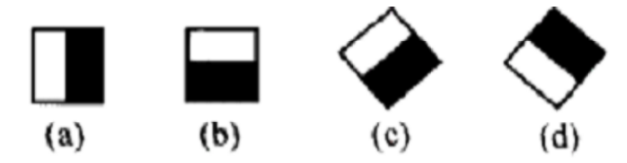
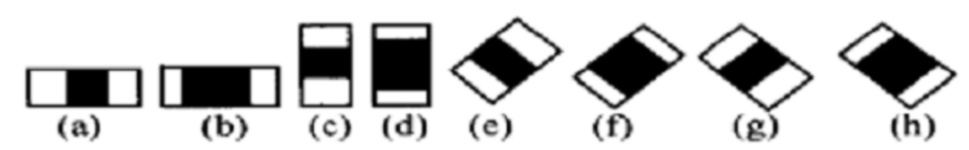
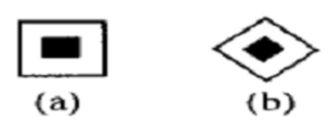
Cell detection
Haar cascade + Adaboost
Boundaries
Lines
Points

Slide 5
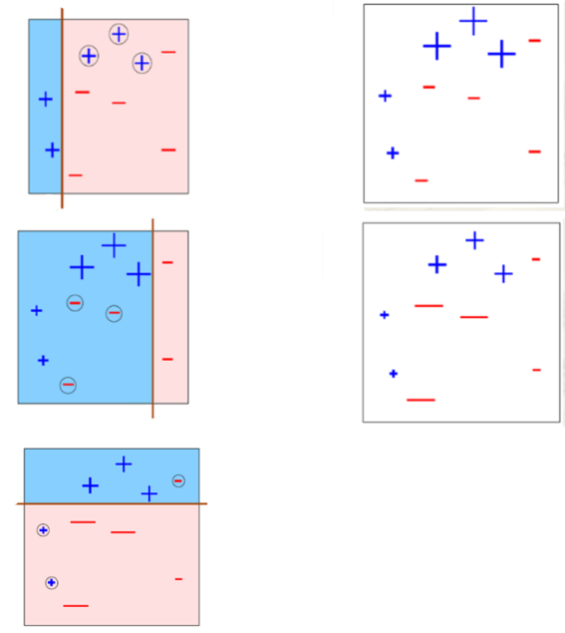
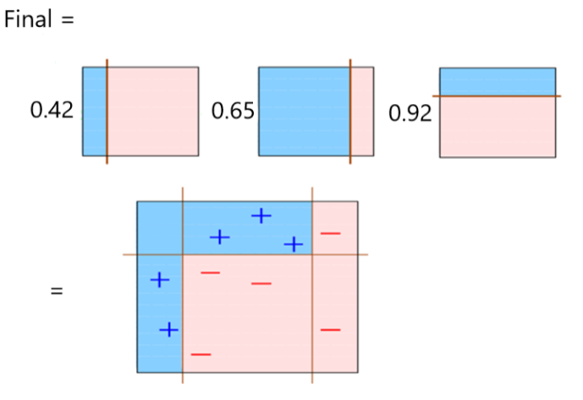
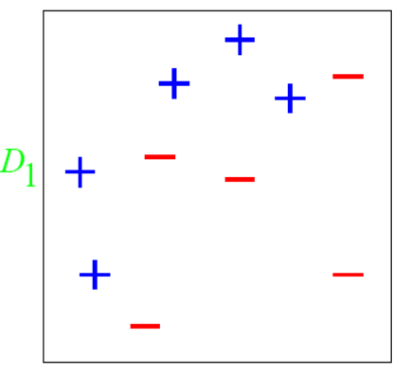
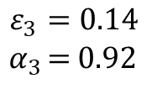
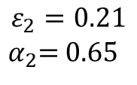
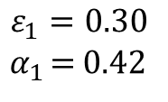
Cell detection
D₂
$$ε_{1}=0.30$$
${ α}_{1 }$= 0.42
D₁
$$ε_{2}=0.21$$
${ α}_{2}$= 0.65
h₂
D₃
$$ε_{3}=0.14$$
${ α}_{3 }$= 0.92

Slide 6
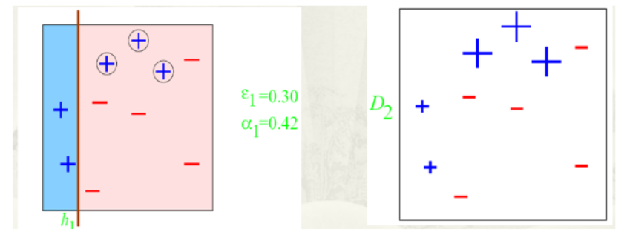
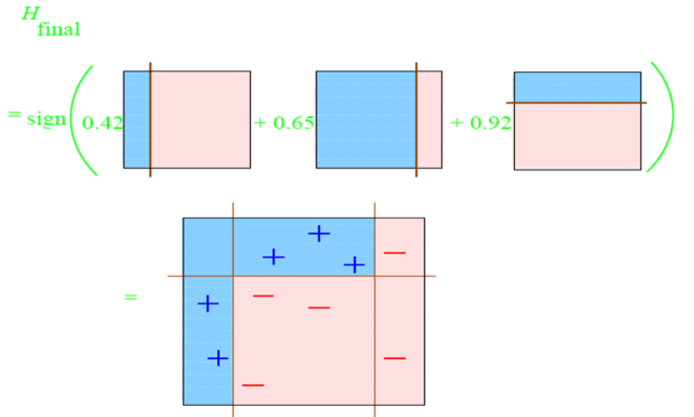
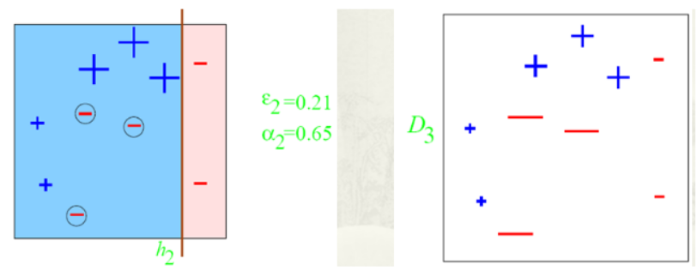
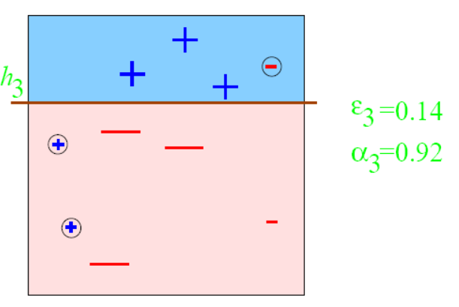
Cell detection

Slide 7
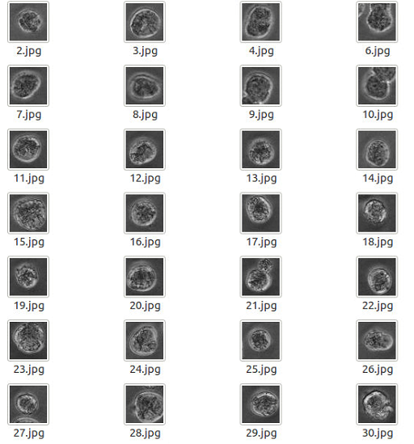
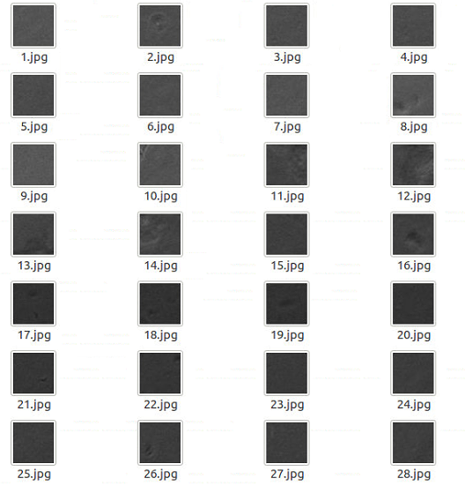

200 Positives
400 Negatives
Detector

Slide 9
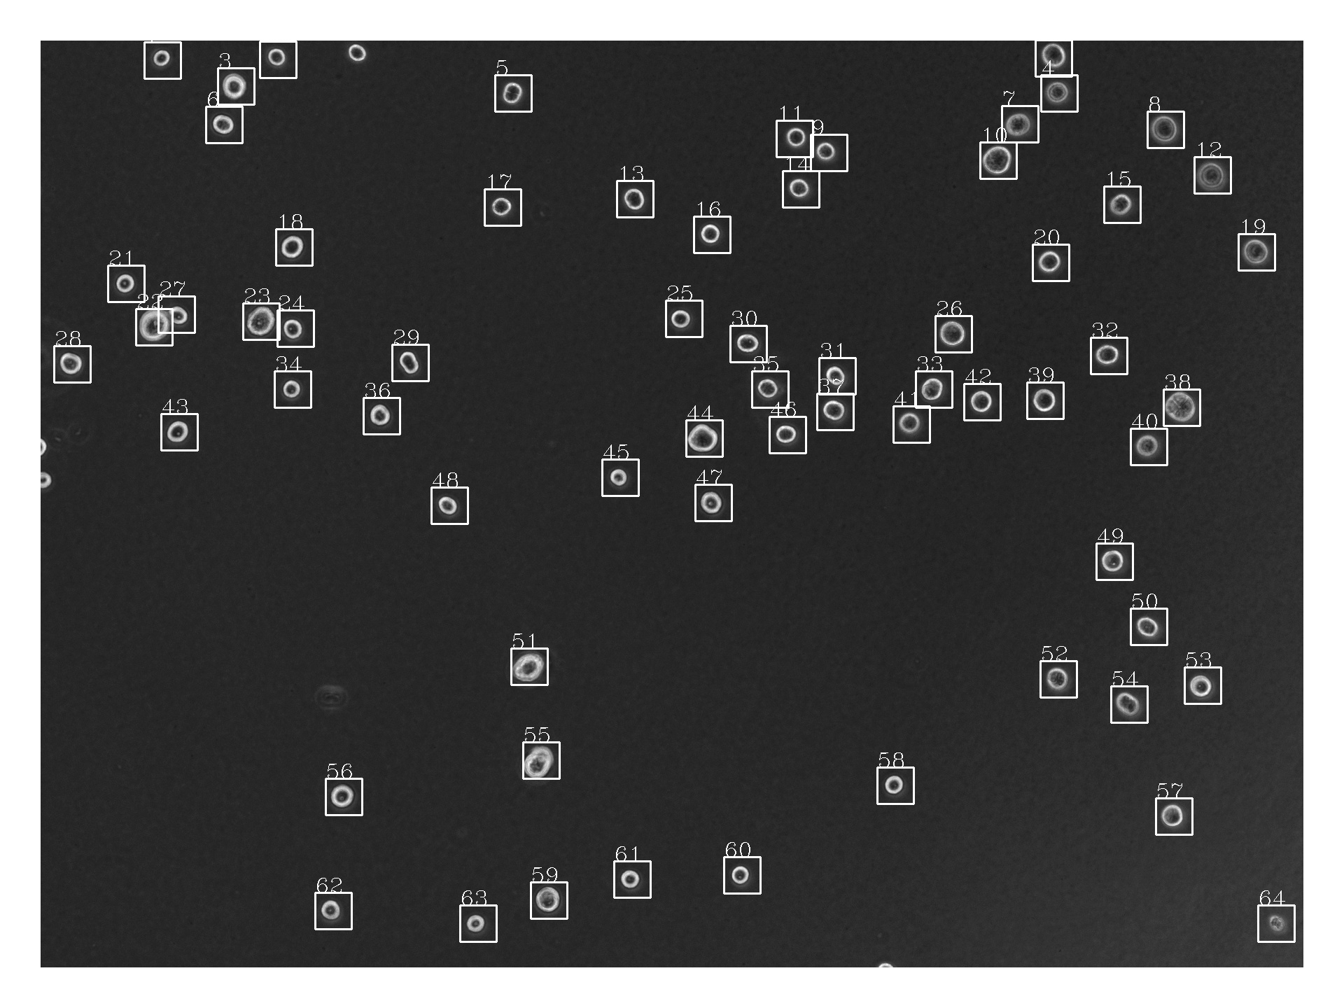
(x, y, w, h)

Slide 10
Feature Vector Formulation
Rotation degree template matching
Cut out the cell from former frame, rotate it [-20, 20] degrees to make 41 copies of the same cell
Comparing these 41 cells to the same cell in the next frame, computing SSIM
Choosing the optimal degree that has the highest SSIM
Notes:
I am going to illustrate this topic from four sections. Our motivations to do this, the ResNet Solution, our newly proposed Hybrid Risk Network Architecture and our future endeavors

Slide 11
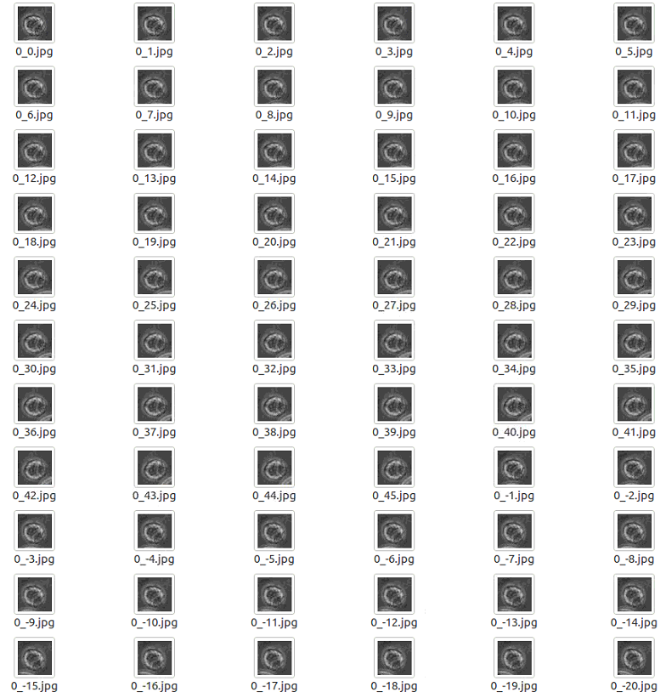



Notes:
I am going to illustrate this topic from four sections. Our motivations to do this, the ResNet Solution, our newly proposed Hybrid Risk Network Architecture and our future endeavors

Slide 12
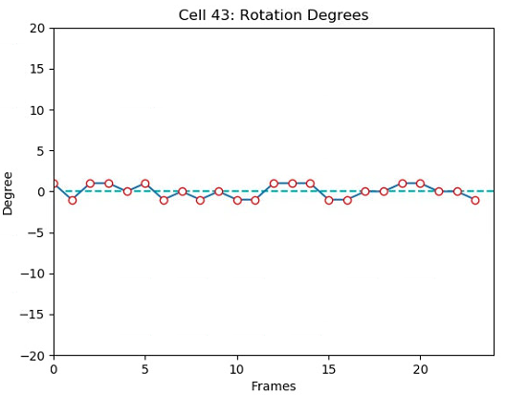
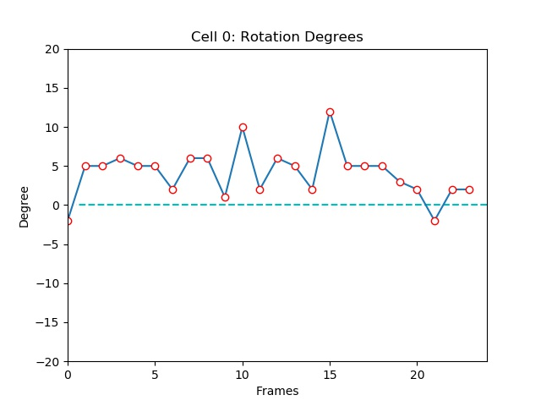
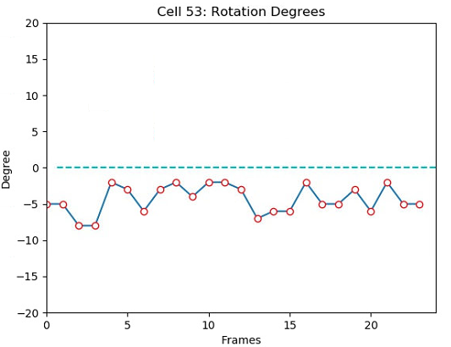
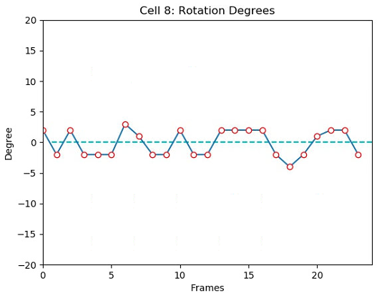
NoRotation
Complex
ClockWise
CounterClockWise

Slide 13
Feature Vector Formulation
As the labeled video have 25 frames, so we use 24 dimensional vector (inter frame degree motion) as feature vectors
For each video, we can generate a number_of_cells * 24 feature vector txt
Ground truth have 4 videos, altogether 90 cells, thus our training data is 90*24 vectors
Using training data to train a SVM model
Notes:
I am going to illustrate this topic from four sections. Our motivations to do this, the ResNet Solution, our newly proposed Hybrid Risk Network Architecture and our future endeavors

Slide 14
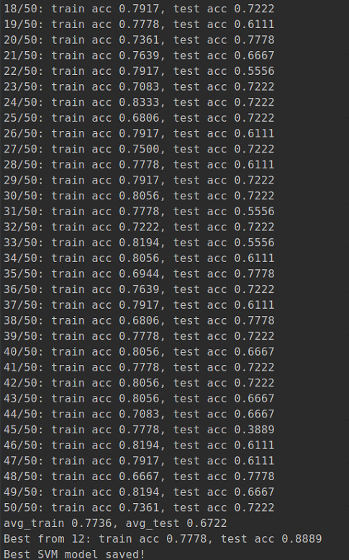

Training SVMs
Randomly split 90 by 72 for training, 18 for testing
50 cross validation
Save the SVM model with highest testing acc
Notes:
I am going to illustrate this topic from four sections. Our motivations to do this, the ResNet Solution, our newly proposed Hybrid Risk Network Architecture and our future endeavors

Slide 15
Software demo development
Load the video wherever you want
Dividing your video equally and extract 25 frames
Using cascade.xml to detect cells location, saved in cells_loc.txt
(x, y, w, h) stands for coordinates of the center, and width/height
Extract all cells’ degree vectors frame by frame, this would take some time
Loading the my_svm.pickle to classify each degree vector
Draw results on video using color code:
CW, CCW, NR/Cplx
Notes:
I am going to illustrate this topic from four sections. Our motivations to do this, the ResNet Solution, our newly proposed Hybrid Risk Network Architecture and our future endeavors

Slide 16
Further try
PCA to reduce dimensionality on 24-vector to 3D
Average of 24 add to feature space
Standard deviation of 24 add to feature space
Maximum value
Minimum value
Notes:
I am going to illustrate this topic from four sections. Our motivations to do this, the ResNet Solution, our newly proposed Hybrid Risk Network Architecture and our future endeavors

Slide 17
Future needs
More training data are required, we only need location and status
Inter frame cells redetection, as some cells are moving, causing the center to vary a little bit
Notes:
I am going to illustrate this topic from four sections. Our motivations to do this, the ResNet Solution, our newly proposed Hybrid Risk Network Architecture and our future endeavors

